Slide 1
Quality Management
CO5: Student will be able to demonstrate and evaluate real time projects with respect to software engineering principles

Slide 2
Quality Concepts

Slide 3
What is Quality Management
Also called software quality assurance (SQA)
Serves as an umbrella activity that is applied throughout the software process
Involves doing the software development correctly versus doing it over again
Reduces the amount of rework, which results in lower costs and improved time to market
Encompasses
  A software quality assurance process
  Specific quality assurance and quality control tasks (including formal technical reviews and a multi-tiered testing strategy)
  Effective software engineering practices (methods and tools)
  Control of all software work products and the changes made to them

Slide 4
Quality Defined
Defined as a characteristic or attribute of something
Refers to measurable characteristics that we can compare to known standards
In software it involves such measures as cyclomatic complexity, cohesion, coupling, function points, and source lines of code
Includes variation control
  A software development organization should strive to minimize the variation between the predicted and the actual values for cost, schedule, and resources
  They should make sure their testing program covers a known percentage of the software from one release to another.
  One goal is to ensure that the variance in the number of bugs is also minimized from one release to another

Slide 5
Quality Defined (continued)
Two kinds of quality are sought out
  Quality of design
    The characteristic that designers specify for an item
    This encompasses requirements, specifications, and the design of the system
  Quality of conformance (i.e., implementation)
    The degree to which the design specifications are followed during manufacturing
    This focuses on how well the implementation follows the design and how well the resulting system meets its requirements
Quality also can be looked at in terms of user satisfaction
User satisfaction = compliant product + good quality
+ delivery within budget and schedule

Slide 6
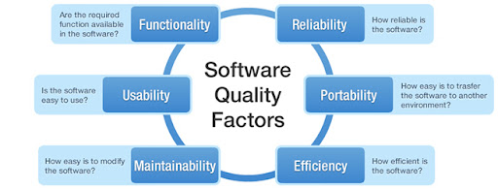
Software Quality Factors

Slide 7
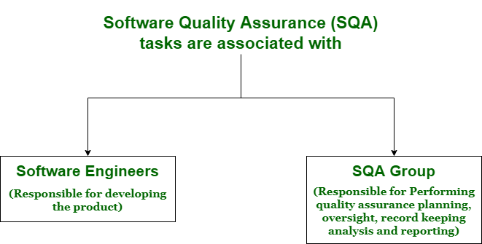

Slide 8
Quality Control
Involves a series of inspections, reviews, and tests used throughout the software process
Ensures that each work product meets the requirements placed on it
Includes a feedback loop to the process that created the work product
  This is essential in minimizing the errors produced
Combines measurement and feedback in order to adjust the process when product specifications are not met
Requires all work products to have defined, measurable specifications to which practitioners may compare to the output of each process

Slide 9
Quality Assurance Functions
Consists of a set of auditing and reporting functions that assess the effectiveness and completeness of quality control activities
Provides management personnel with data that provides insight into the quality of the products
Alerts management personnel to quality problems so that they can apply the necessary resources to resolve quality issues

Slide 10
The Cost of Quality
Includes all costs incurred in the pursuit of quality or in performing quality-related activities
Is studied to
  Provide a baseline for the current cost of quality
  Identify opportunities for reducing the cost of quality
  Provide a normalized basis of comparison (which is usually dollars)
Involves various kinds of quality costs
Increases dramatically as the activities progress from
  Prevention → Detection → Internal failure → External failure
"It takes less time to do a thing right than to explain why you did it wrong." Longfellow

Slide 11
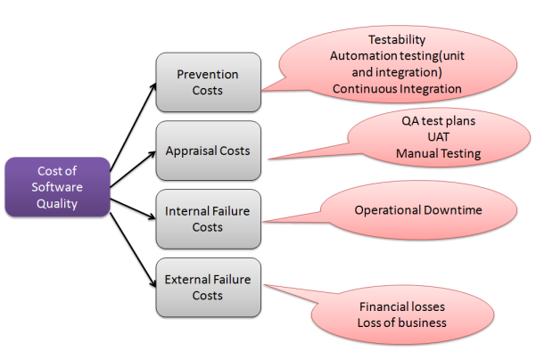
Kinds of Quality Costs

Slide 12
Kinds of Quality Costs
Prevention costs
  Quality planning, formal technical reviews, test equipment, training
Appraisal costs
  Inspections, equipment calibration and maintenance, testing
Failure costs – subdivided into internal failure costs and external failure costs
  Internal failure costs
    Incurred when an error is detected in a product prior to shipment
    Include rework, repair, and failure mode analysis
  External failure costs
    Involves defects found after the product has been shipped
    Include complaint resolution, product return and replacement, help line support, and warranty work

Slide 13
Software Quality Assurance

Slide 14
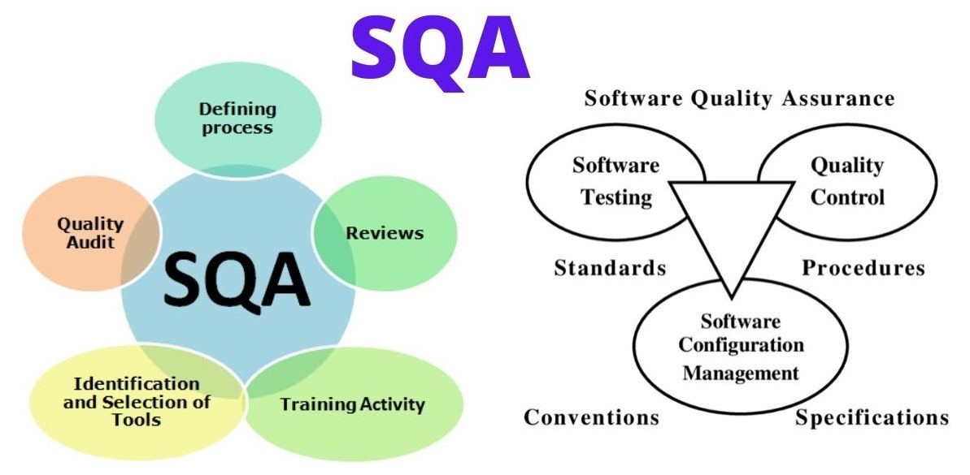

Slide 15
Software Quality Defined
Definition: "Conformance to explicitly stated functional and performance requirements, explicitly documented development standards, and implicit characteristics that are expected of all professionally developed software"

Slide 16
Software Quality Defined (continued)
This definition emphasizes three points
  Software requirements are the foundation from which quality is measured; lack of conformance to requirements is lack of quality
  Specified standards define a set of development criteria that guide the manner in which software is engineered; if the criteria are not followed, lack of quality will almost surely result
  A set of implicit requirements often goes unmentioned; if software fails to meet implicit requirements, software quality is suspect
Software quality is no longer the sole responsibility of the programmer

Slide 17
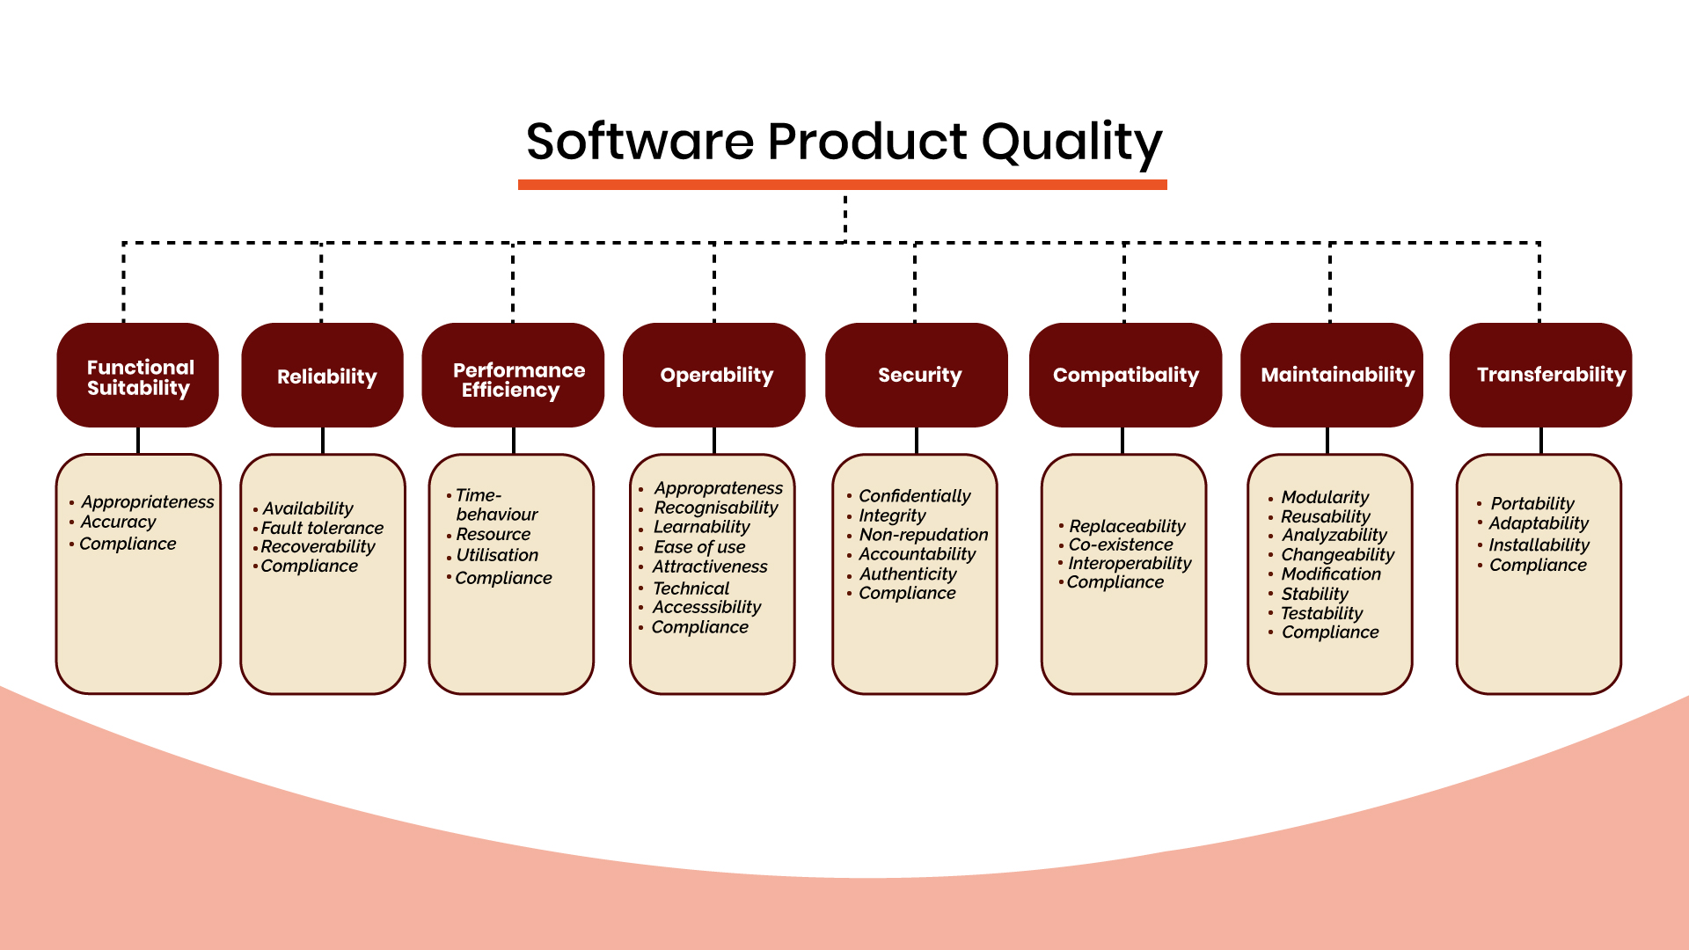

Slide 18
The SQA Group
Serves as the customer's in-house representative
Assists the software team in achieving a high-quality product
Views the software from the customer's point of view
  Does the software adequately meet quality factors?
  Has software development been conducted according to pre-established standards?
  Have technical disciplines properly performed their roles as part of the SQA activity?
Performs a set of of activities that address quality assurance planning, oversight, record keeping, analysis, and reporting (See next slide)

Slide 19
SQA Activities
Prepares an SQA plan for a project
Participates in the development of the project's software process description
Reviews software engineering activities to verify compliance with the defined software process
Audits designated software work products to verify compliance with those defined as part of the software process
Ensures that deviations in software work and work products are documented and handled according to a documented procedure
Records any noncompliance and reports to senior management
Helps to collect and analyze software metrics

Slide 20
Software Reviews

Slide 21
Purpose of Reviews
Serve as a filter for the software process
Are applied at various points during the software process
Uncover errors that can then be removed
Purify the software analysis, design, coding, and testing activities
Catch large classes of errors that escape the originator more than other practitioners
Include the formal technical review (also called a walkthrough or inspection)
Require the software engineers to expend time and effort, and the organization to cover the costs

Slide 22
Formal Technical Review (FTR)
Objectives
  To uncover errors in function, logic, or implementation for any representation of the software
  To verify that the software under review meets its requirements
  To ensure that the software has been represented according to predefined standards
  To achieve software that is developed in a uniform manner
  To make projects more manageable
Serves as a training ground for junior software engineers to observe different approaches to software analysis, design, and construction
May sometimes be a sample-driven review
  Project managers must quantify those work products that are the primary targets for formal technical reviews
  The sample of products that are reviewed must be representative of the products as a whole

Slide 23
The FTR Meeting
Has the following constraints
  From 3-5 people should be involved
  Advance preparation (i.e., reading) should occur for each participant but should require no more than two hours a piece and involve only a small subset of components
  The duration of the meeting should be less than two hours
Focuses on a specific work product (a software requirements specification, a detailed design, a source code listing)
Activities before the meeting
  The producer informs the project manager that a work product is complete and ready for review
  The project manager contacts a review leader, who evaluates the product for readiness, generates copies of product materials, and distributes them to the reviewers for advance preparation
  Each reviewer spends one to two hours reviewing the product and making notes before the actual review meeting
  The review leader establishes an agenda for the review meeting and schedules the time and location

Slide 24
The FTR Meeting (continued)
Activities during the meeting
  The meeting is attended by the review leader, all reviewers, and the producer
  One of the reviewers also serves as the recorder for all issues and decisions concerning the product
  After a brief introduction by the review leader, the producer proceeds to "walk through" the work product while reviewers ask questions and raise issues
  The recorder notes any valid problems or errors that are discovered; no time or effort is spent in this meeting to solve any of these problems or errors
Activities at the conclusion of the meeting
  All attendees must decide whether to
    Accept the product without further modification
    Reject the product due to severe errors (After these errors are corrected, another review will then occur)
    Accept the product provisionally (Minor errors need to be corrected but no additional review is required)

Slide 25
The FTR Meeting (continued)
Activities following the meeting
  The recorder produces a list of review issues that
    Identifies problem areas within the product
    Serves as an action item checklist to guide the producer in making corrections
  The recorder includes the list in an FTR summary report
    This one to two-page report describes what was reviewed, who reviewed it, and what were the findings and conclusions
  The review leader follows up on the findings to ensure that the producer makes the requested corrections

Slide 26
FTR Guidelines
Review the product, not the producer
Set an agenda and maintain it
Limit debate and rebuttal; conduct in-depth discussions off-line
Enunciate problem areas, but don't attempt to solve the problem noted
Take written notes; utilize a wall board to capture comments
Limit the number of participants and insist upon advance preparation
Develop a checklist for each product in order to structure and focus the review
Allocate resources and schedule time for FTRs
Conduct meaningful training for all reviewers
Review your earlier reviews to improve the overall review process

Slide 27
Statistical Software Quality Assurance

Slide 28
Process Steps
Collect and categorize information (i.e., causes) about software defects that occur
Attempt to trace each defect to its underlying cause (e.g., nonconformance to specifications, design error, violation of standards, poor communication with the customer)

Slide 29
A Sample of Possible Causes for Defects
Incomplete or erroneous specifications
Misinterpretation of customer communication
Intentional deviation from specifications
Violation of programming standards
Errors in data representation
Inconsistent component interface
Errors in design logic
Incomplete or erroneous testing
Inaccurate or incomplete documentation
Errors in programming language translation of design
Ambiguous or inconsistent human/computer interface

Slide 30
Six Sigma
Popularized by Motorola in the 1980s
Is the most widely used strategy for statistical quality assurance
Uses data and statistical analysis to measure and improve a company's operational performance
Identifies and eliminates defects in manufacturing and service-related processes
The "Six Sigma" refers to six standard deviations (3.4 defects per a million occurrences)

Slide 31
Six Sigma (continued)
Three core steps
  Define customer requirements, deliverables, and project goals via well-defined methods of customer communication
  Measure the existing process and its output to determine current quality performance (collect defect metrics)
  Analyze defect metrics and determine the vital few causes (the 20%)
Two additional steps are added for existing processes (and can be done in parallel)
  Improve the process by eliminating the root causes of defects
  Control the process to ensure that future work does not reintroduce the causes of defects

Slide 32
Six Sigma (continued)
All of these steps need to be performed so that you can manage the process to accomplish something
You cannot effectively manage and improve a process until you first do these steps (in this order):
Manage and improve the work process
Control the work process
Analyze the work process
Measure the work process
Define the work process
The work to be done

Slide 33
Software Reliability, Availability, and Safety

Slide 34
Reliability and Availability
Software failure
  Defined: Nonconformance to software requirements
  Given a set of valid requirements, all software failures can be traced to design or implementation problems (i.e., nothing wears out like it does in hardware)
Software reliability
  Defined: The probability of failure-free operation of a software application in a specified environment for a specified time
  Estimated using historical and development data
  A simple measure is MTBF = MTTF + MTTR = Uptime + Downtime
  MTBF (Mean Time Between Failures) describes the time between to failures.
  MTTF (Mean Time To Failure) describes the time up to the first failure.
  MTTR (Mean Time To Recover) is the time that it takes to repair those failed devices.
  Example:
    MTBF = 68 days + 3 days = 71 days
    Failures per 100 days = (1/71) * 100 = 1.4

Slide 35
Software availability
  Defined: The probability that a software application is operating according to requirements at a given point in time
  Availability = [MTTF/ (MTTF + MTTR)] * 100%
  Example:
    Avail. = [68 days / (68 days + 3 days)] * 100 % = 96%

Slide 36
Software Safety
Focuses on identification and assessment of potential hazards to software operation
It differs from software reliability
  Software reliability uses statistical analysis to determine the likelihood that a software failure will occur; however, the failure may not necessarily result in a hazard or mishap
  Software safety examines the ways in which failures result in conditions that can lead to a hazard or mishap; it identifies faults that may lead to failures
Software failures are evaluated in the context of an entire computer-based system and its environment through the process of fault tree analysis or hazard analysis

Slide 37
SQA Plan

Slide 38
Purpose and Layout
Provides a road map for instituting software quality assurance in an organization
Developed by the SQA group to serve as a template for SQA activities that are instituted for each software project in an organization
Structured as follows:
  The purpose and scope of the plan
  A description of all software engineering work products that fall within the purview of SQA
  All applicable standards and practices that are applied during the software process
  SQA actions and tasks (including reviews and audits) and their placement throughout the software process
  The tools and methods that support SQA actions and tasks
  Methods for assembling, safeguarding, and maintaining all SQA-related records
  Organizational roles and responsibilities relative to product quality

